Slide 1


National institute of technology Warangal
AI Travel Planner
Presentation by
M.Hindu(SRU 3rd yr)
S.Dhanush(SRU 3rd yr)
P.Kaveri(GCET 3rd yr)
P.Sai Prasanna(GLWEC 3rd yr)
Under the Gudience of
Prof.T.Kishore Kumar,Dept of ECE

Slide 2
Contents
Introduction
Literature Review
Motivation
Objectives
Work Flow
Methodology
Block diagram
Description
Results
Conclusion
References

Slide 3

Revolutionizing Travel with AI:
Introduction
The AI Travel Planner is an intelligent system designed to simplify and personalize the travel planning process. Instead of manually searching for destinations, hotels, and places to visit, users simply enter basic details such as their age, travel dates, budget, and interests like nature, spirituality, photography, or shopping. Based on this information, the system automatically suggests the most suitable travel destination, along with a complete day-by-day itinerary. This includes nearby tourist spots, hotel suggestions within budget, meal plans, weather updates, and maps for navigation. By leveraging AI algorithms and real-time data, the planner offers a smart and efficient way to plan trips that are tailored to the user's preferences, making travel planning more enjoyable and hassle-free.

Slide 4

AI Travel Planner: Discover Your Dream Destination
Problem Statement
Planning a trip involves multiple complex decisions such as selecting a suitable destination, finding budget-friendly accommodations, identifying places of interest, checking weather conditions, and organizing a daily schedule. This process can be time-consuming, overwhelming, and often results in suboptimal travel experiences—especially for individuals who lack travel expertise or time for research. Moreover, existing travel platforms offer limited personalization based on factors like age, interests, and budget. Hence, there is a need for an intelligent system that can automate and personalize the entire travel planning process using AI, making it efficient, user-friendly, and tailored to individual preferences.

Slide 5
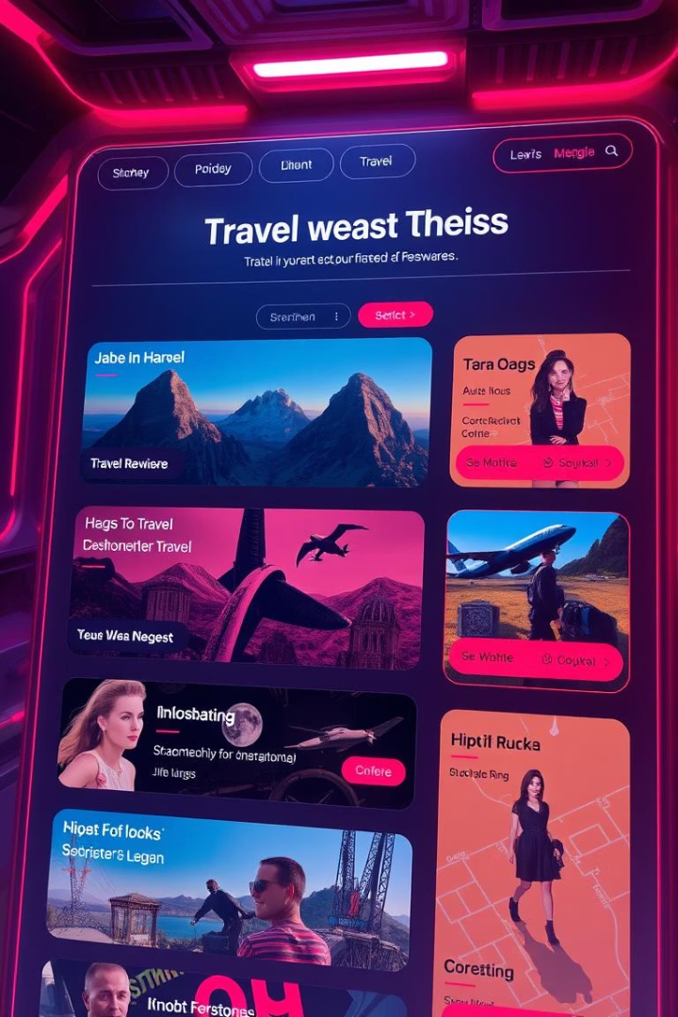
AI Travel Planner: Components
Frontend: HTML, CSS, JavaScript – For user interface and input forms.
Backend: Python with Flask – To handle user requests, processing, and API integration.
Data Storage: JSON or SQLite – For storing destination, hotel, and interest data.
Recommendation Engine: Python logic – Matches age, budget, and interest to suggest locations.
Itinerary Generator: Python – Generates day-wise plans with timings.
Weather Integration: OpenWeatherMap API – To get real-time weather forecasts .
Map & Location Services: Google Maps API – For place locations and directions.

Slide 6

AI Travel Planner: Literature Survey
Paper Title
Personalized Travel Recommendation Systems using Machine Learning
Authors
P. Goyal, R. Srivastava, A. Malhotra
Publication/year
2021
Research Area/ Subtopic
Machine Learning & Travel Personalization
Dataset
User travel preferences and budget profiles
Problem Defined
How can travel be personalized using ML based on user budget and preferences?
Description
ML algorithms are used to analyze user data and recommend suitable travel plans.
Contribution
Suggests destinations and accommodations tailored to user needs.
Limitation/Drawbacks
Data sparsity; cold-start problem for new users

Slide 7
Literature Survey
Paper Title
Rule-Based Travel Planning Systems
Authors
M. Smith, L. Johnson
Publication/year
2019
Research Area/ Subtopic
Rule-Based Systems & Travel Recommendation
Dataset
User age, budget, and travel preferences
Problem Defined
Can rules based on user characteristics provide reliable travel suggestions?
Description
Uses IF-THEN rules to generate travel plans based on profiles.
Contribution
Simple and low-resource travel planning system
Limitation/Drawbacks
Not adaptive to complex or dynamic preferences

Slide 8
Literature Survey
Paper Title
AI-Powered Travel Assistants: Enhancing User Experience
Authors
S. Lee, J. Kim
Publication/year
2020
Research Area/ Subtopic
Artificial Intelligence & User Experience
Dataset
User mood and financial data
Problem Defined
How can AI enhance travel planning using mood and financial inputs?
Description
Uses AI for mood analysis and budget-aware trip personalization.
Contribution
Provides more intuitive and satisfying travel recommendations
Limitation/Drawbacks
Privacy concerns with sensitive data

Slide 9
Literature Survey
Paper Title
Budget-Conscious Travel Planning: Techniques and Challenges
Authors
R. Gupta, A. Verma
Publication/year
2018
Research Area/ Subtopic
Budget Segmentation & Cost Optimization
Dataset
Regional travel cost datasets
Problem Defined
How to plan cost-effective travel without reducing experience quality?
Description
Focuses on budget optimization in trip planning
Contribution
Offers budget clustering for efficient trip suggestions
Limitation/Drawbacks
Real-time cost data often missing or outdated

Slide 10

Issues in the literature
Lack of personalized travel suggestions
No end-to-end itinerary automation
Static and generic destination recommendations
Missing detailed day-wise planning
Complex and non-user-friendly interfaces
Minimal use of AI for smart decision-making

Slide 11

Motivation
Travel planning is often time-consuming and overwhelming.
Existing platforms do not offer personalized suggestions based on age, budget, and interests.
Users face difficulty in manually creating detailed, day-wise itineraries.
Real-time data like weather and local events are often missing in current solutions.
There is a growing demand for intelligent systems that simplify travel decisions.
The goal is to develop an AI-powered planner that provides complete, customized travel plans efficiently.

Slide 12




Objectives
Simplify & Personalize Planning
Enable Cost-Effective & Fulfilling Decisions
Provide Daily Curated Recommendations
Support Diverse Travelers
Support diverse travelers across various budgets and age groups through intelligent, AI-driven suggestions.
Personalize travel planning using age, budget, and trip duration to simplify the process.
Help users make travel decisions that are both cost-effective and emotionally satisfying.
Offer daily curated recommendations for hotels, attractions, and meals to ease decision-making.

Slide 13
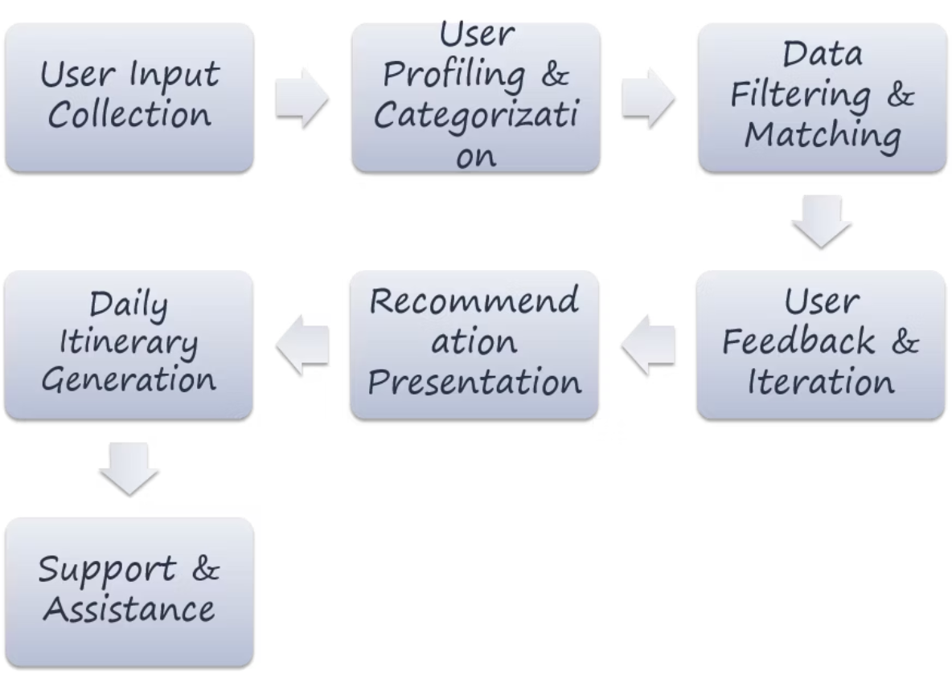
Work Flow

Slide 14





Methodology
User Input & Profiling
Collect age, travel dates, budget, and interests; classify user profile.
Data Collection & Categorization
Organize destinations, hotels, and activities by type, cost, and location.
Intelligent Filtering & Matching
Match inputs with suitable places using rules and real-time weather data.
Daily Itinerary Generation
Generate day-wise plan with activities, hotels, food, and timings.
User Interface & Feedback
Display results on a user-friendly UI; collect feedback for improvements.

Slide 15
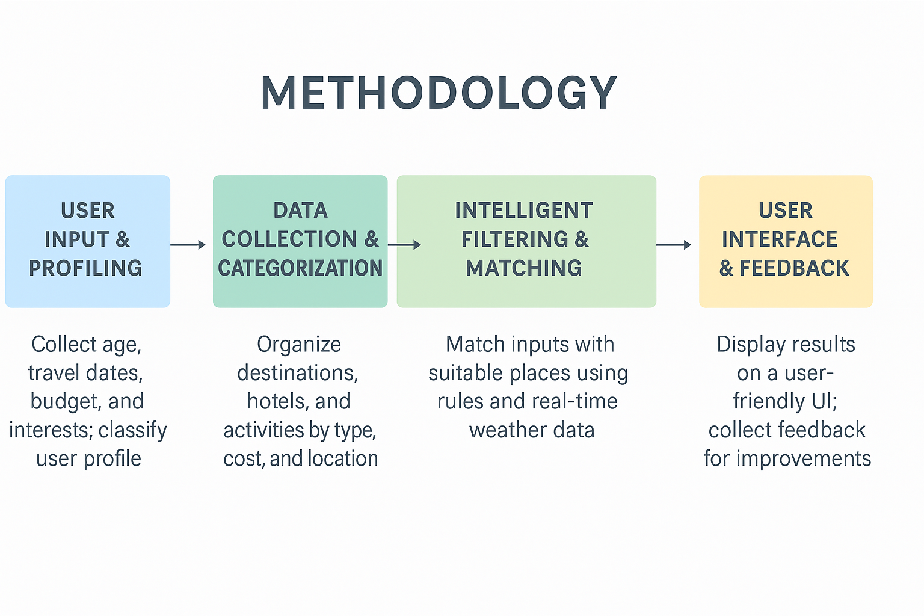

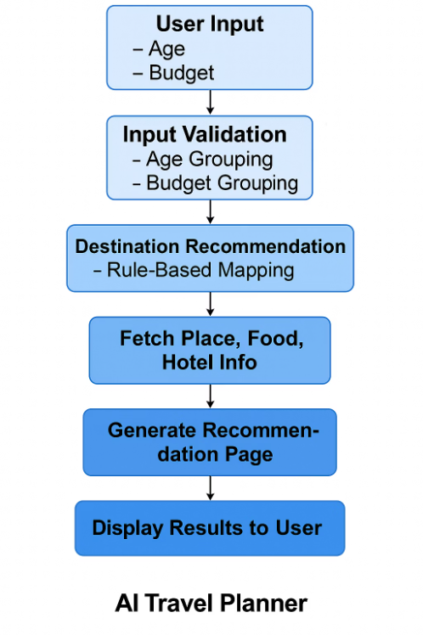
Block Diagram
BLOCK DIAGRAM
User Input: The user enters their age and budget.
Input Validation: The system checks and groups the input into categories (e.g., age group and budget level).
Destination Recommendation: Based on predefined rules, it maps the age and budget to a suitable travel type (e.g., cultural, adventurous).
Fetch Place, Food, Hotel Info: It retrieves specific destinations, local foods, and hotel options matching the mapped category.
Generate Recommendation Page: A personalized result page is created with all the suggestions.
Display Results to User: The webpage displays the travel recommendations clearly for the user.
This makes travel planning automatic, personalized, and efficient.

Slide 16

Expected Output
Suggested travel destination based on age, budget, interests, and travel dates
Day-wise itinerary (morning, afternoon, evening, night plans)
List of nearby hotels and restaurants
Real-time weather forecast for each travel day
Map locations for all places in the itinerary
Displayed via a user-friendly web interface
Option to download or share the complete plan

Slide 17
Description
The AI Travel Planner is a smart web-based application designed to simplify the travel planning process. By taking user inputs such as age, budget, travel dates, and interests (e.g., nature, spirituality, photography, shopping), the system intelligently suggests the most suitable destination. It then generates a complete, personalized day-wise itinerary including activities, nearby hotels, food options, weather updates, and map locations. The planner uses rule-based filtering, real-time API integrations, and a user-friendly interface to deliver a seamless and tailored travel experience. It eliminates the need for manual research and helps users plan trips that match their preferences and constraints.

Slide 18








AI Travel Planner: Future Scope
The future of AI in travel promises even more immersive and intuitive experiences.
Voice and Emotion Recognition
Future AI will understand your voice and emotional state.
Integration with Smart Wearables
Seamlessly sync with devices for real-time travel data.
Eco-Friendly Travel Options
Prioritize sustainable choices for environmentally conscious travel.
AI Chatbot for Real-Time Support
Instant assistance during your journey with AI chatbots.

Slide 19
AI Travel Planner: Conclusion
The AI Travel Planner simplifies and personalizes the entire travel planning process by combining user
preferences with intelligent filtering, real-time data, and automated itinerary generation. It not only
saves time and effort but also enhances the overall travel experience by delivering smart, tailored,
and user-friendly trip plans.

Slide 20
References
P. Goyal, R. Srivastava, and A. Malhotra, "A Personalized Travel Recommendation System Using Machine Learning," International Journal of Advanced Computer Science and Applications, vol. 12, no. 5, pp. 489–496, 2021.
Ministry of Tourism, Government of India, "Tourism Statistics Report," Tourism Data API, 2023. [Online]. Available: https://tourism.gov.in/
H. Al-Nazer and M. A. Abushariah, "Tourist Attraction Recommendation System Based on User Interests," Journal of Computer Science, vol. 18, no. 2, pp. 103–110, 2022.
N. Singh and R. Tiwari, "An AI-Based Itinerary Planner for Tourists Based on Preferences and Budget," IEEE International Conference on Smart Technologies and Management for Computing, Communication, Controls, Energy and Materials, pp. 139–143, 2021.
A. Gupta, V. Goel, and M. Saini, "AI in Travel Recommendation Systems: A Review," Procedia Computer Science, vol. 187, pp. 462–468, 2021.

Slide 21

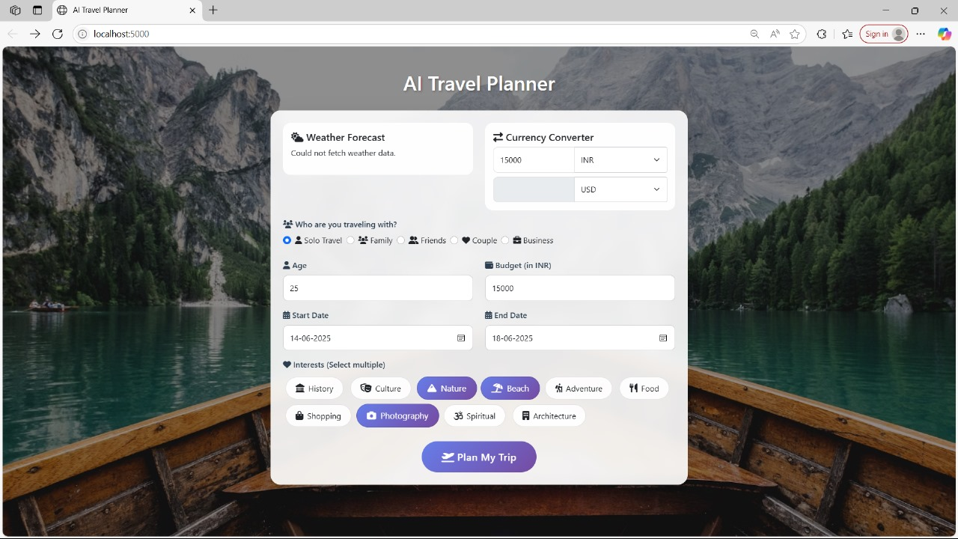
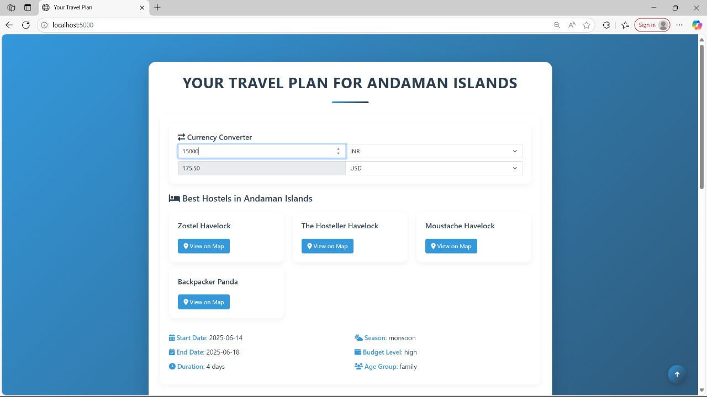
Results

Slide 22

Thank You

